Slide 1


Protecting competition in a changing world
Competition & Competitiveness: Problems and Solutions
Tomaso Duso
Brussel, 15 October 2024

Slide 2


The roadmap
    State of competition in the EU
    The EU competitiveness problem
    Competition & Competitiveness
    Policy implications
EC – Protecting competition in a changing world
LEAR et al. Exploring aspects of the state of competition in the EU
OECD
Exploring the evolution and state of competition in the EU
DG Comp’s internal workstreams
Tomaso Duso – Competition & Competitiveness: Problems and solutions
Notes:
Orally you can perhaps mention that the Draghi Report came later and refers twice our report.

Slide 3
The state of competition in the EU

Slide 4
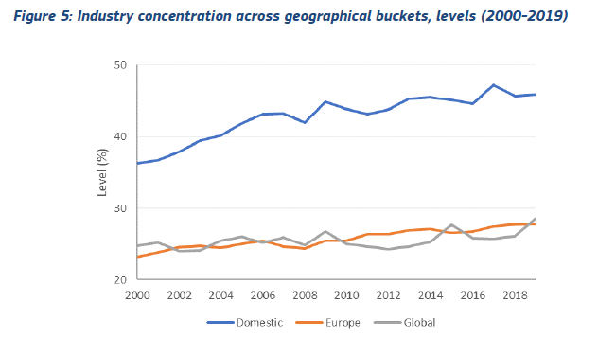
Industry concentration is increasing
    Average industry CR4 increased by 5 percentage points between 2000-2019 for a sample of 127 industries across 15 European countries
    Especially in industries competing at the national level
Source: OECD (Calligaris et al., 2024)
Tomaso Duso – Competition & Competitiveness: Problems and solutions

Slide 5
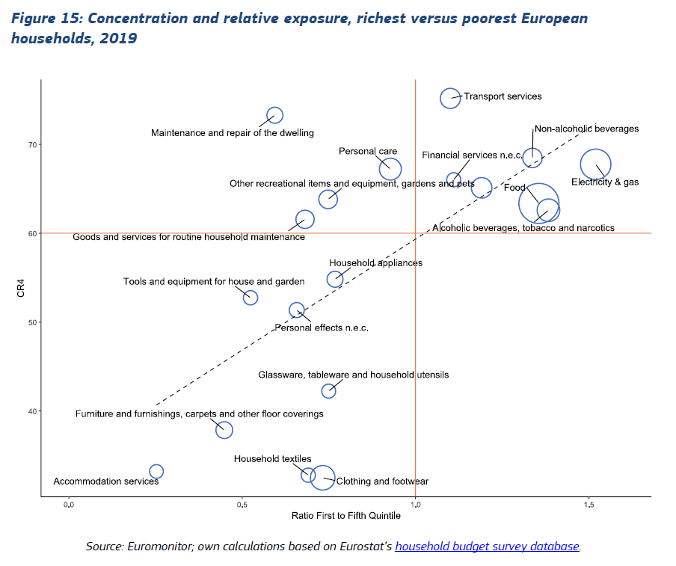
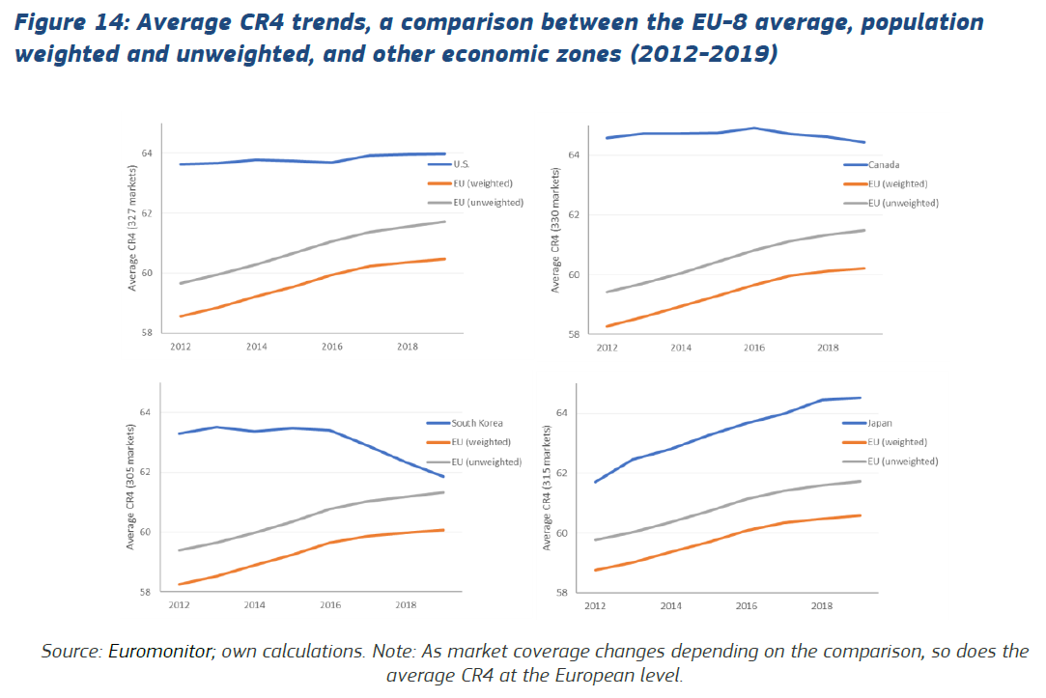
Concentration in consumer-facing (B2C) markets is increasing even more
Source: DG COMP (2024)
    Concentration has increased most in sectors crucial to low-income households, raising both efficiency and equity concerns.
Tomaso Duso – Competition & Competitiveness: Problems and solutions

Slide 6
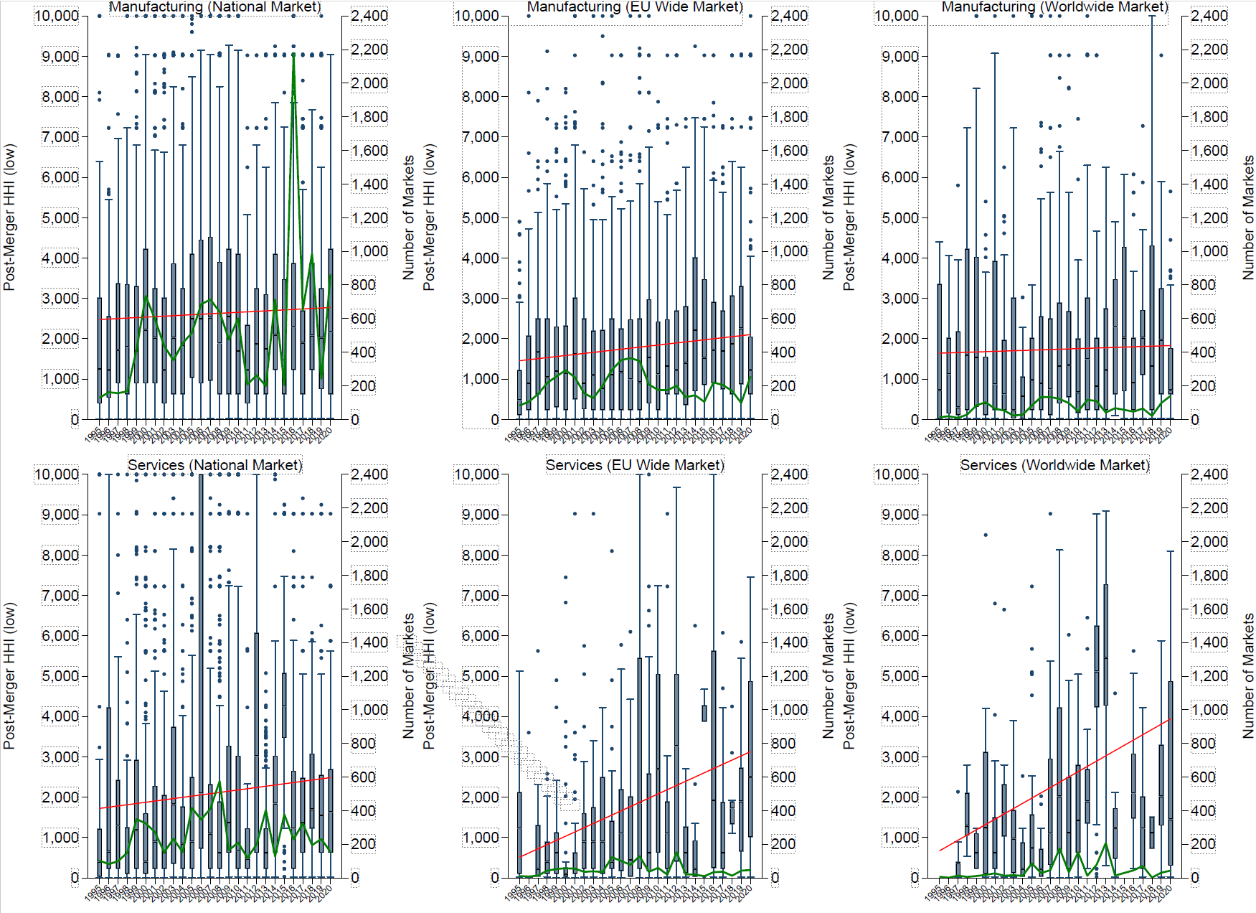
…and in antitrust markets too
      National-wide
      EU-wide
      World-wide
      Manufacturing
      Services
      Source: Affeldt, P., T. Duso, K. Gugler, J. Piechucka, 2021, “Market Concentration in Europe: Evidence from Antitrust Markets,” CEPR DP 15699
Tomaso Duso – Competition & Competitiveness: Problems and solutions

Slide 7
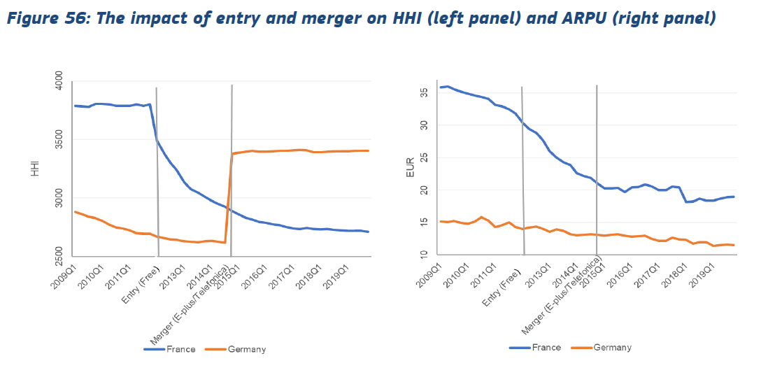
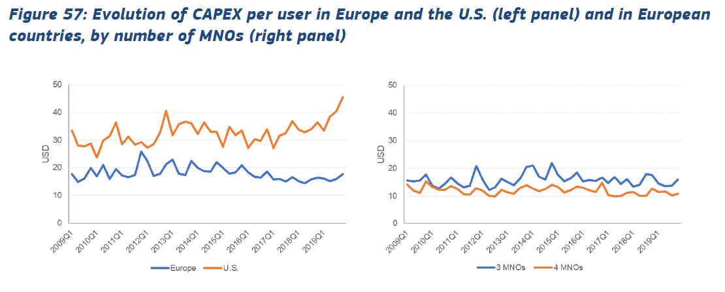
Concentration in mobile telecoms increases prices and reduces investment
    Regression analysis suggests that one additional mobile network operator (MNO) is associated with
    7% reduction in ARPU (9% when only focusing on Europe)
    9% higher aggregate investment
Source: LEAR et al. (2024)
Tomaso Duso – Competition & Competitiveness: Problems and solutions

Slide 8
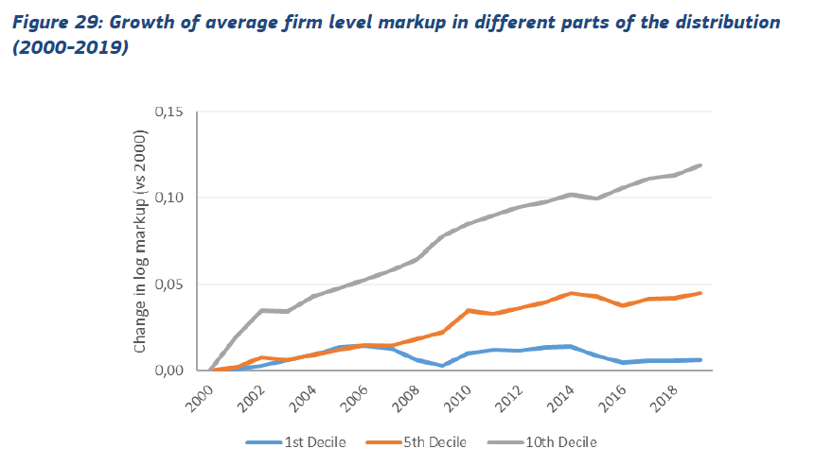
Markups are also increasing
    Average firm-level markups increased by ca. 7% between 2000 and 2019
    At the top of the distribution: increase of ca. 12%
    Primarily took place in (i) digitally intensive industries and (ii) services
Source: OECD (Calligaris et al., 2024)
Tomaso Duso – Competition & Competitiveness: Problems and solutions

Slide 9
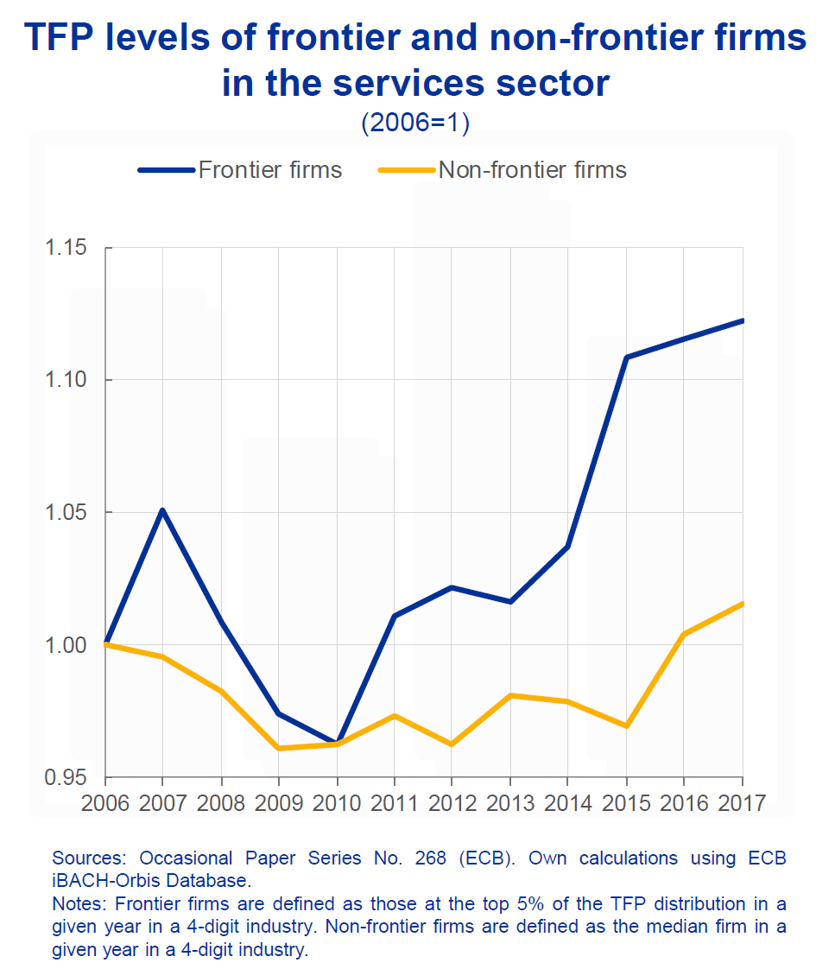
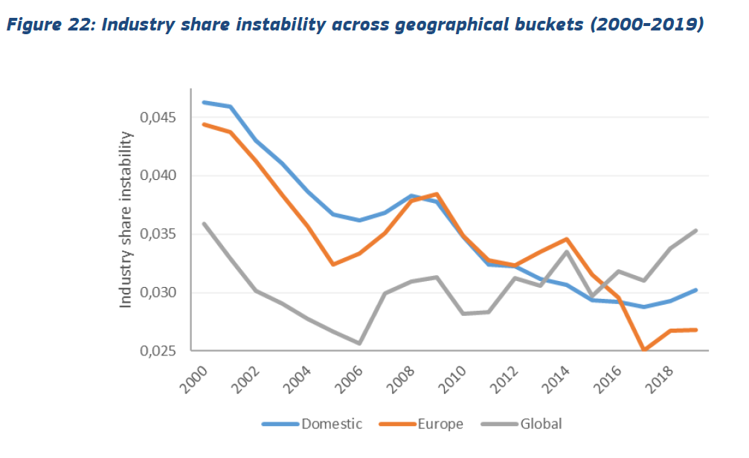
Growing gap between leaders and followers and decline in business dynamism
      Source: Isabel Schnabel (2024)
Source: OECD (Calligaris et al., 2024)
Tomaso Duso – Competition & Competitiveness: Problems and solutions
Notes:
Growing gap between leaders and followers and declining competitive disruption at the top.
High barriers to entry protect the rents of incumbents, reduce technology diffusion and constrain the entry of younger firms, which are more likely to innovate

Slide 10
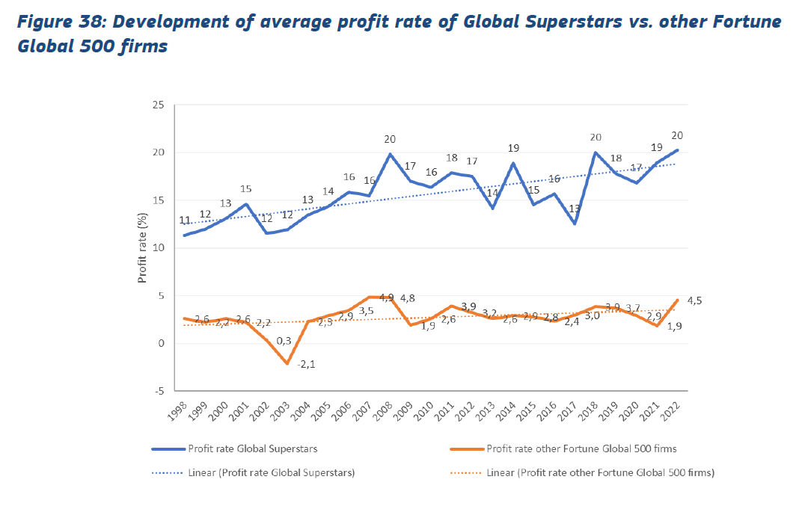
Superstar firms and the increase in profits
Source: LEAR et al. (2024)
Tomaso Duso – Competition & Competitiveness: Problems and solutions
Notes:
The rise of the superstars has led to reduced creative destruction/incentives to innnovate/invest. See Aghion, Akcigit, De Ridder

Slide 11
Key takeaways
    Concentration and market power dynamics
    Independent on the metrics, increasing concentration across many industries & markets
    …especially in smaller and highly-concentrated markets
    Key drivers: barriers to entry, rise of intangibles, mergers and merger policy
    Concentration leads to higher prices and lower investment
    Markups and profits have increased, especially at the top
    High barriers to entry protect the rents of incumbents, reduce technology diffusion and constrain the entry of younger firms
    The rise of superstar firms has reduced creative destruction and weakened incentives to innovate and invest
Tomaso Duso – Competition & Competitiveness: Problems and solutions

Slide 12
The European competitiveness problem

Slide 13
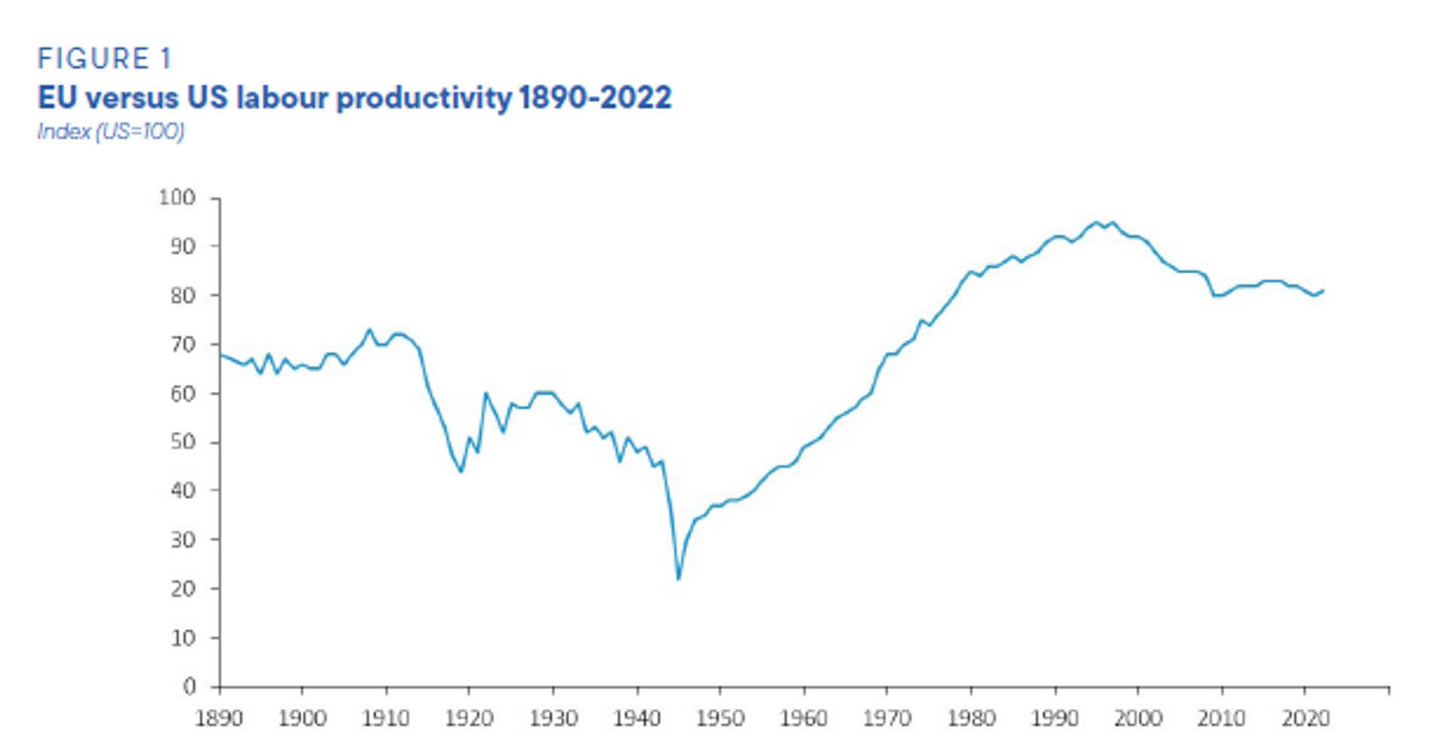
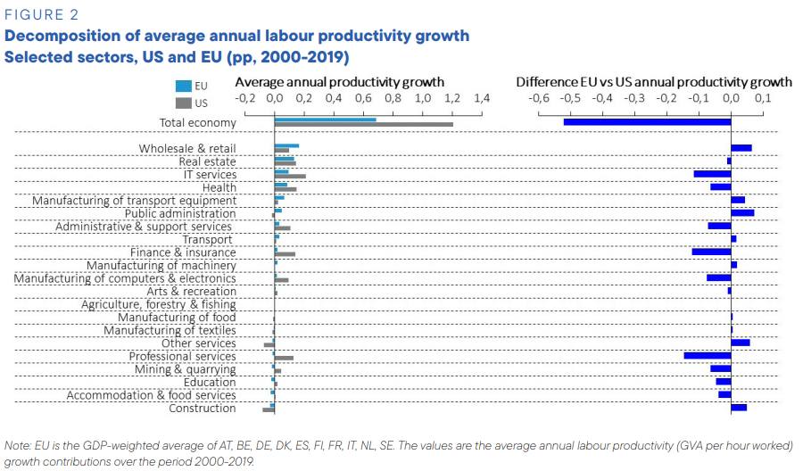
Productivity gap
      Source: Draghi report (2024)
Tomaso Duso – Competition & Competitiveness: Problems and solutions

Slide 14
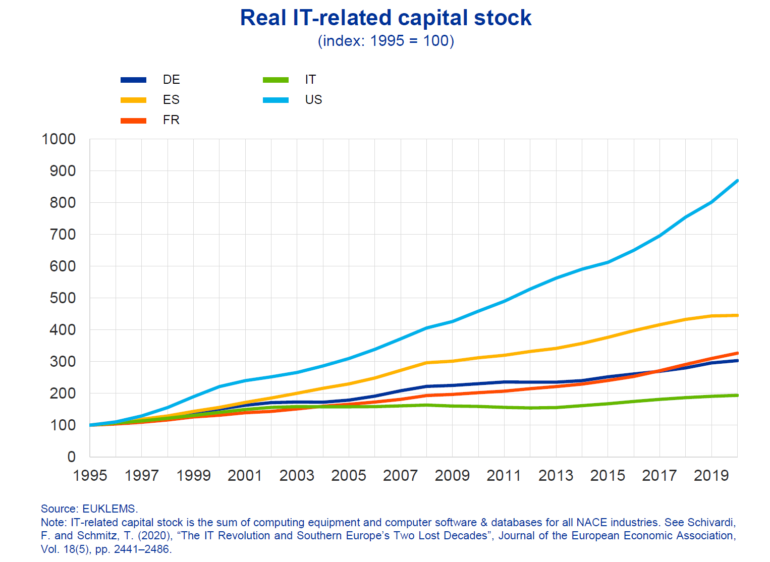
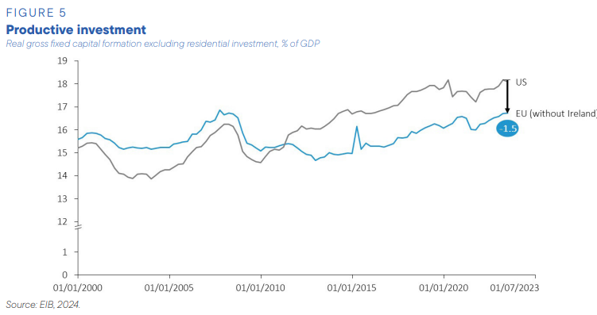
Investment gap and the digital capital stock
      Source: Draghi report (2024)
      Source: Isabel Schnabel (2024)
Tomaso Duso – Competition & Competitiveness: Problems and solutions

Slide 15
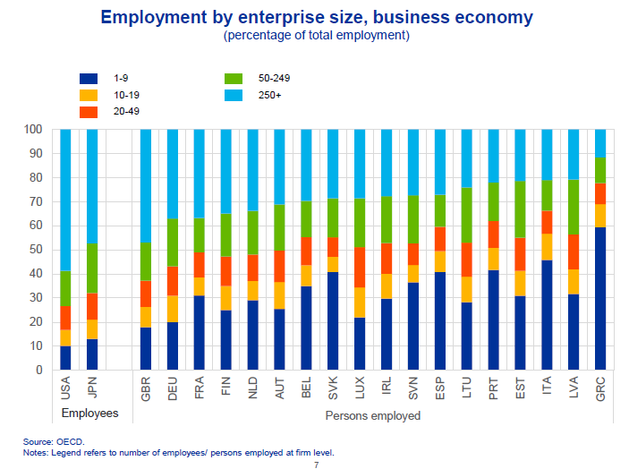
Firms’ size matters for investment
      Source: Isabel Schnabel (2024)
Tomaso Duso – Competition & Competitiveness: Problems and solutions
Notes:
Firm size is a key factor driving ICT investments, as the fixed costs related to process reorganisation weigh particularly on SMEs. High administrative requirements make it harder for euro area firms to grow to a sufficient size. In the United States, firms with more than 250 employees account for almost 60% of total employment (Slide 7). In the euro area, the share is between 12 and 37%.

Slide 16
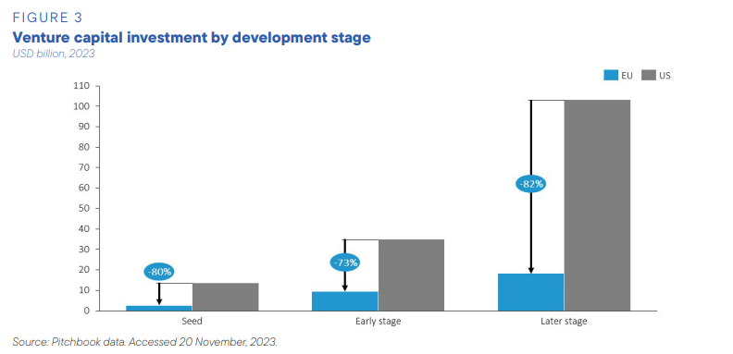
Lack of access to capital
      Source: Draghi report (2024)
Tomaso Duso – Competition & Competitiveness: Problems and solutions
Notes:
Similarly, the lack of external capital often makes it difficult for firms to scale up. In the euro area, venture capital investments are much lower than in the United States, so that many innovative

Slide 17
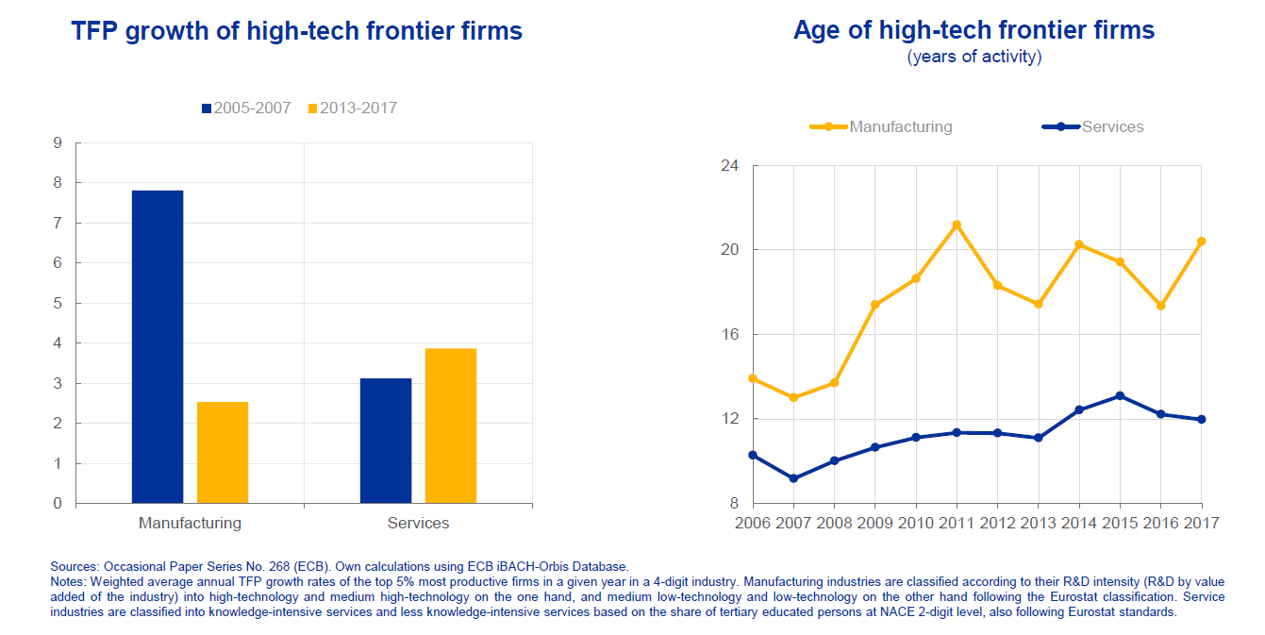
Decline of frontier firms
      Source: Isabel Schnabel (2024)
Tomaso Duso – Competition & Competitiveness: Problems and solutions
Notes:
The marked decline in productivity growth of high-tech frontier firms in this sector during the past decade coincided with a measurable slowdown in business dynamism(

Slide 18
The role of competition as a key driver of competitiveness

Slide 19
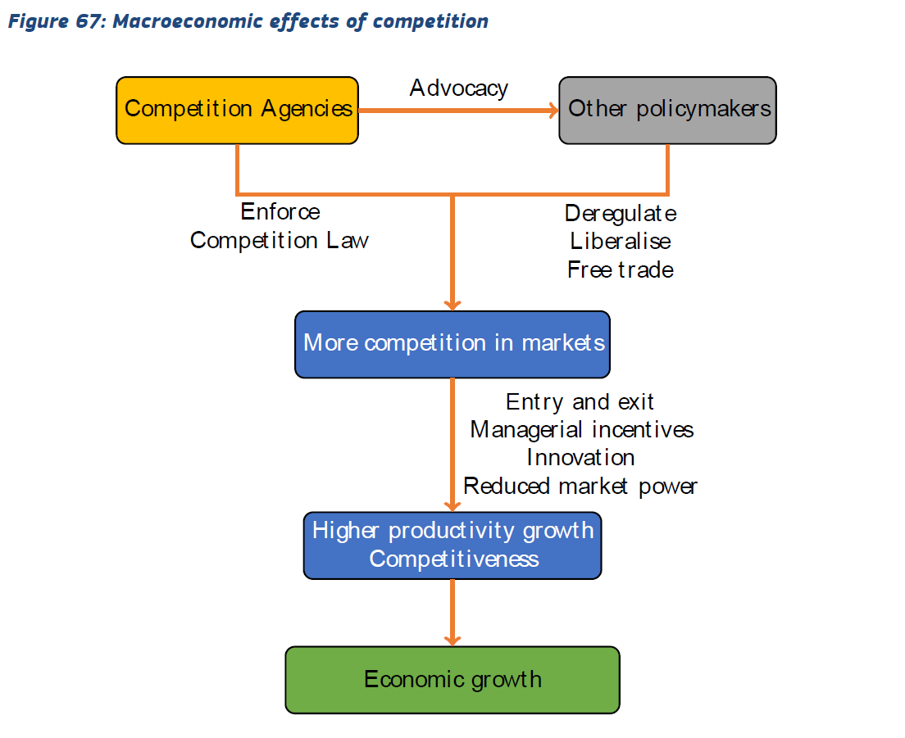

Competition as key driving force for competitiveness
Source: OECD (2014)
Tomaso Duso – Competition & Competitiveness: Problems and solutions

Slide 20
Evidence I: Competition policy and productivity growth
    Competition policy has a positive causal impact on TFP and LP growth
    The impact is economically significant
      …actual improvement of the CPI in the UK in 2001-2002, is responsible for ca. 1/5 of the increase of TFP growth
    Impact is larger in non-regulated sectors and in countries with better legal institutions
Source: Buccirossi, Ciari, Duso, Spagnolo, & Vitale, Review of Economic and Statistics, 2013
Tomaso Duso – Competition & Competitiveness: Problems and solutions

Slide 21
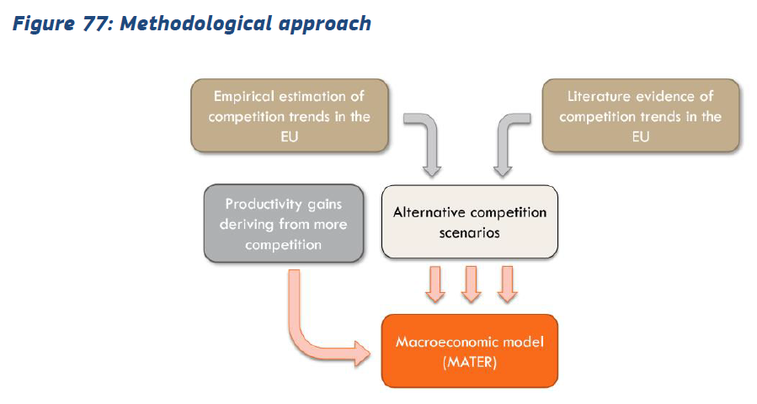
Evidence II: The macroeconomic effects of competition
      Markups increase since 2000 may have reduced EU GDP by up to 5 - 7% compared to the counterfactual
        Without the Commission’s merger and antitrust interventions impact might have been larger by almost one quarter
      Limiting the market power of firms at the top of the markup distribution or pro-competitive reforms across the EU might each increase GDP by up to 2 - 4 %, depending on the time horizon
Source: LEAR et al. (2024)
Tomaso Duso – Competition & Competitiveness: Problems and solutions

Slide 22
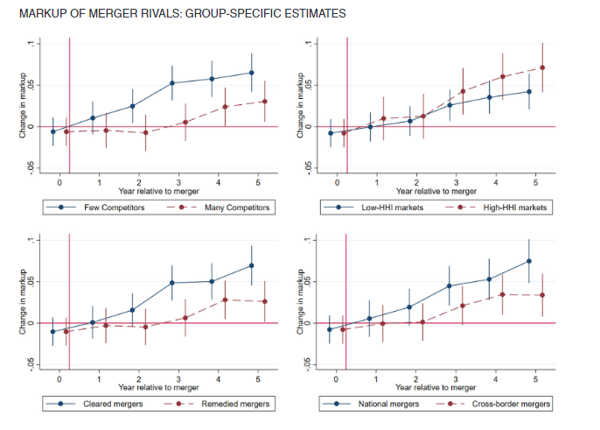
Evidence III: merger control (under)enforcement
      Source: Stiebale and Scüzs (2022)
      Source: Duso et al. (2024)
Tomaso Duso – Competition & Competitiveness: Problems and solutions

Slide 23
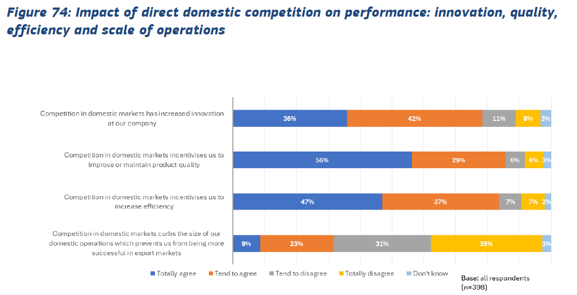
Evidence IV: Competition helps success in global markets
Source: LEAR et al. (2024)
Tomaso Duso – Competition & Competitiveness: Problems and solutions

Slide 24
Summing up and policy implications

Slide 25
What are the problems – The Draghi report and more
    Missing innovation & creative destruction
    A widening gap between market leaders and laggards
      Rising barriers to entry and expansion for new challengers and entrants
      Reduced diffusion of productivity-enhancing innovations lead to “winner-takes-most” dynamics
      Increased concentration, profits, and margins
    Too few inventors succeed in scaling up their innovations
    Investment gaps and the need for scale
    Demand-side: Incomplete internal market for goods and services with persistent cross-country barriers, contradictory regulations, and excessive red tape
    Supply-side: Missing capital market & banking union
    The challenges of our time
    Twin transformation
    New geopolitical order – dependencies & resilience
    Uneven playing field
Tomaso Duso – Competition & Competitiveness: Problems and solutions

Slide 26
Competition and pro-competitive policies as part of the solution
  Open and competitive markets: A coordinated policy approach
    Single market policies and structural reforms: Complete the single market & the capital market and banking unions
    Whole-of-government approach based on competition as (one of the) driving principle(s): competition, industrial, trade, climate policies
    Improving competition policy
      Strengthen merger control: tougher and more focused on dynamics
      Enhance speed and efficiency, especially for State aid/IPCEI
      Coordination with new policy tools (DMA, foreign subsidy regulation, …)
      New competition tool
    A new industrial policy
    Common European
    Strategic: Energy grid, digital infrastructure (broadband, cloud and supercomputer), defense | batteries, semiconductors, vaccines (IPCEI) | Cleantech
    Competition-friendly design
Tomaso Duso – Competition & Competitiveness: Problems and solutions

Slide 28
Evidence on the evolution of competition in the EU and its drivers
Vincent Verouden, Ph.D.
European Commission, DG Competition
Public Workshop
Brussels, 15 October 2024
DISCLAIMER – Any views expressed are those of the author and cannot be regarded as stating an official position of the European Commission.

Slide 29

Indicators of competition used in the report
Concentration measures (CR4)
Markups and profits
Business dynamism

Slide 30


Measuring concentration
Industry level
“Industries”:
  defined relatively broadly, based on supply/production perspective
CR4 based on production shares
  within individual country (or collection of countries). But: what about imports/exports?
  OECD (Calligaris et al. (2024)):
    Industries assessed at 3-digit NACE level (i.e. more granular)
    Industries classified into: Domestic, European, Global
Market level
“Markets”:
  defined more narrowly, based on customer perspective (cf. antitrust)
CR4 based on market shares
  Inhouse work on novel dataset
  of Euromonitor International
    Market sales (at brand level) of consumer products
    B2C only
vs.
NEW
NEW

Slide 31
Findings on industry concentration
Industry concentration: CR4 2000-2019, aggregating across geographical ‘buckets’
Average industry CR4 increased by ~5%p.p. between 2000-2019
Concentration levels and increases highest in
  industries competing at the national level
  and also in industries with high intangibles (ICT, brands, ..)
Source: OECD (Calligaris et al., 2024). Baseline sample
for concentration analysis: 15 EU countries, 127 industries/sectors

Slide 32
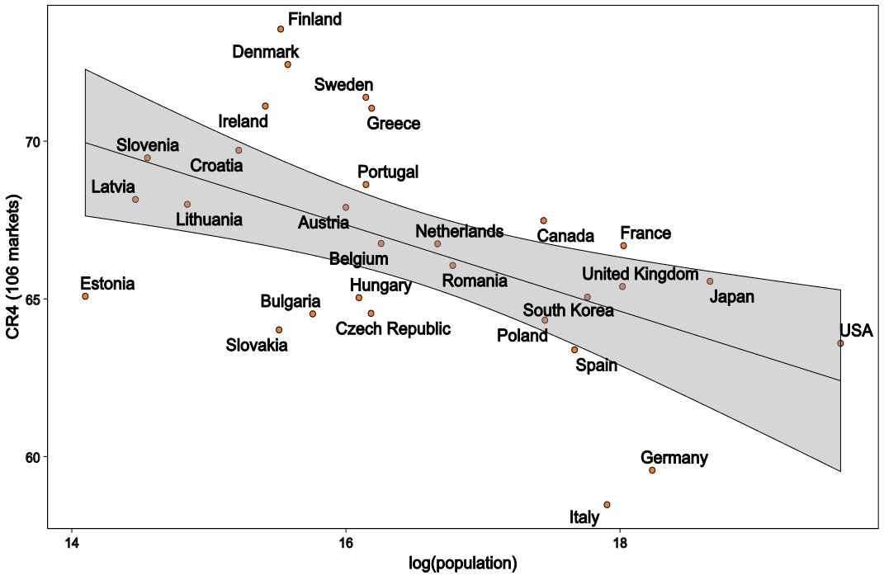
Findings on market concentration
Relation between CR4 and country population
EU average CR4 at market level > 60 % (significantly higher than at industry level)
EU average has increased between 2012 and 2019 (while remaining below US level)
Significant differences between countries, even when controlling for population
Data: Euromonitor International, in-house calculations

Slide 33
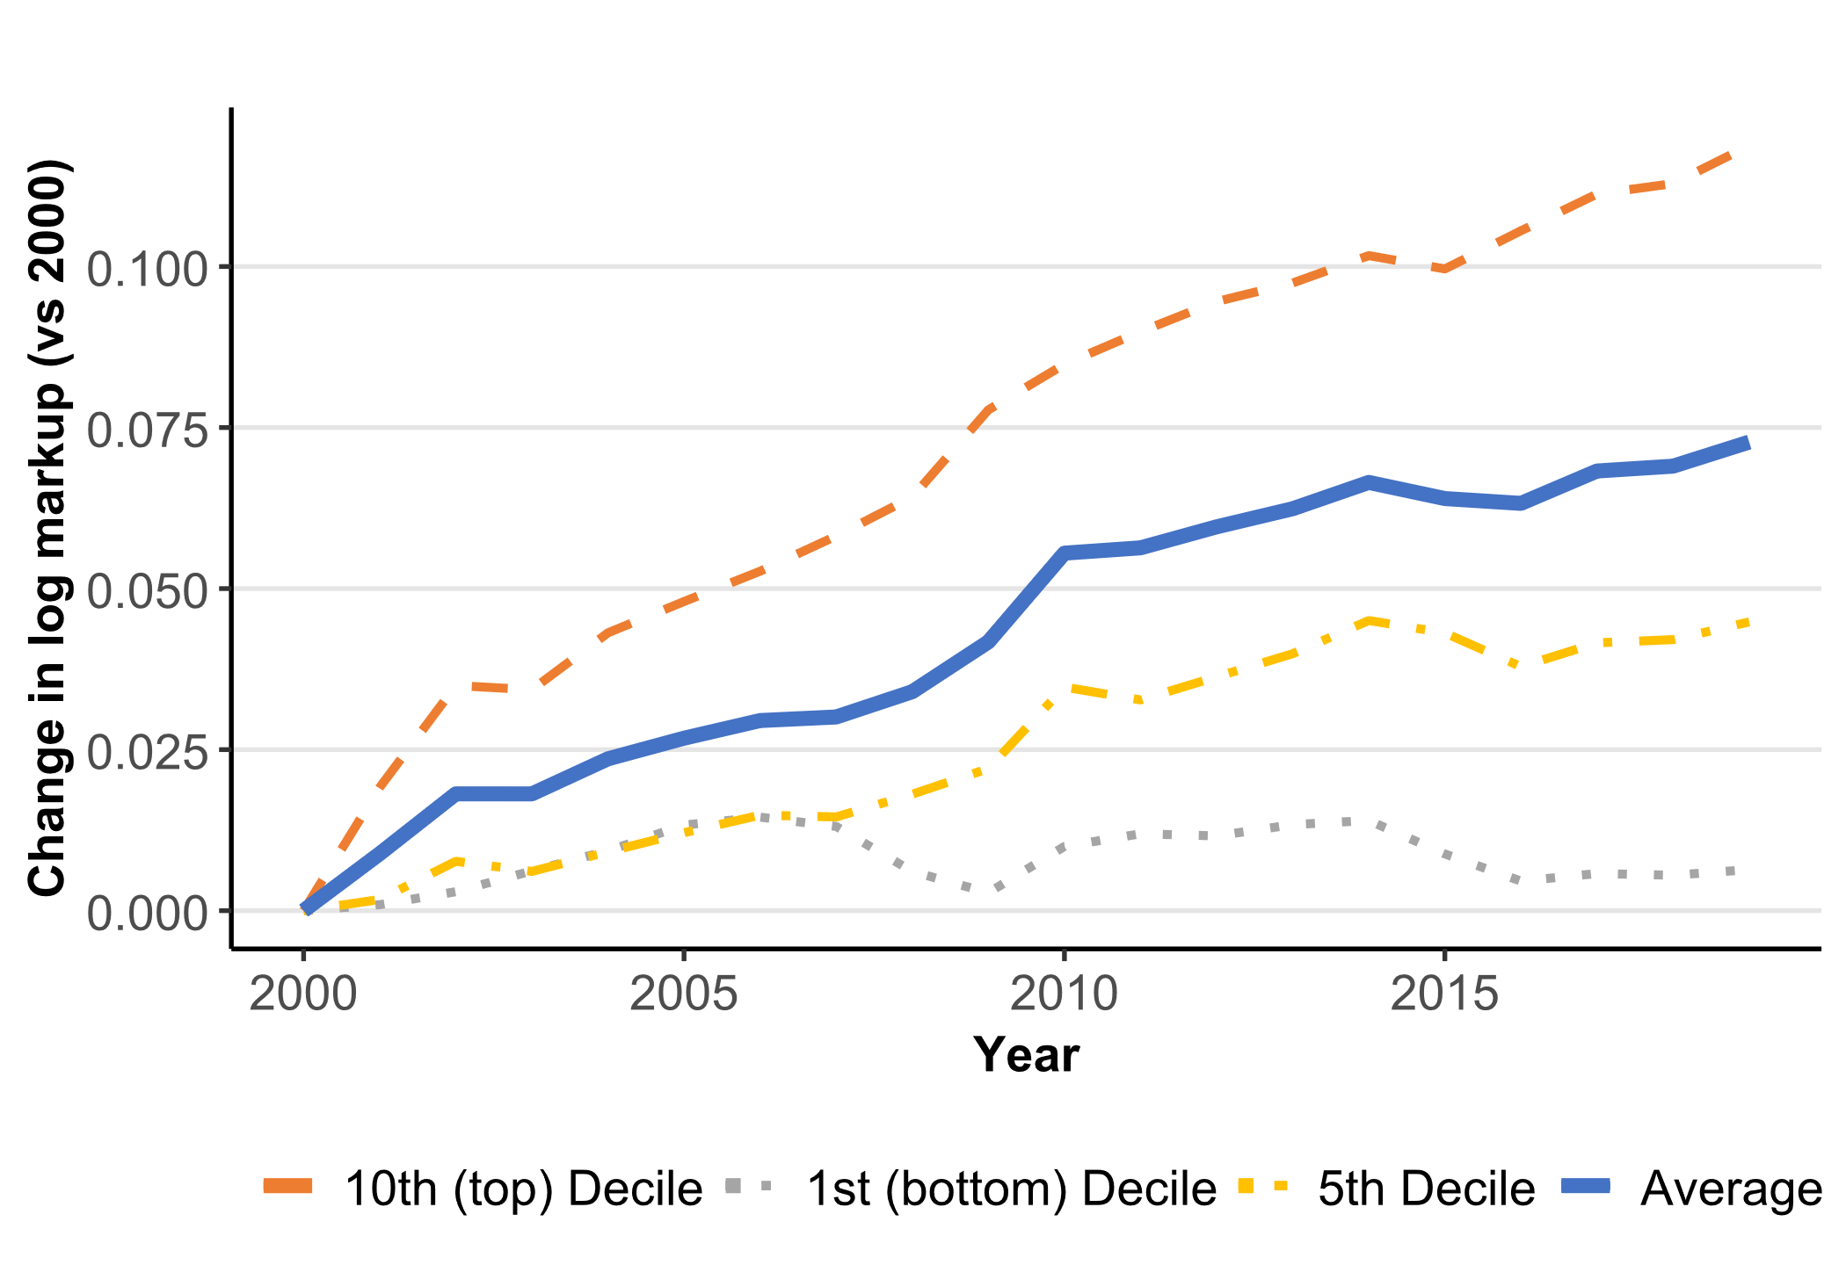

Findings on markups
Markup = price-to-marginal-cost ratio
  An often-used indicator of (static) market power
Average firm-level markups increased by ~7% between 2000 and 2019
  Increase mainly driven by rising markups at the top of the markup distribution
  Increases in markups primarily took place in (i) digitally intensive industries and (ii) services
Growth of firm level markup (2000-2019, unweighted)
Average
Source: OECD (Calligaris et al., 2024). Based on 24 European
countries (23 EU + UK) and 240 sectors.

Slide 34
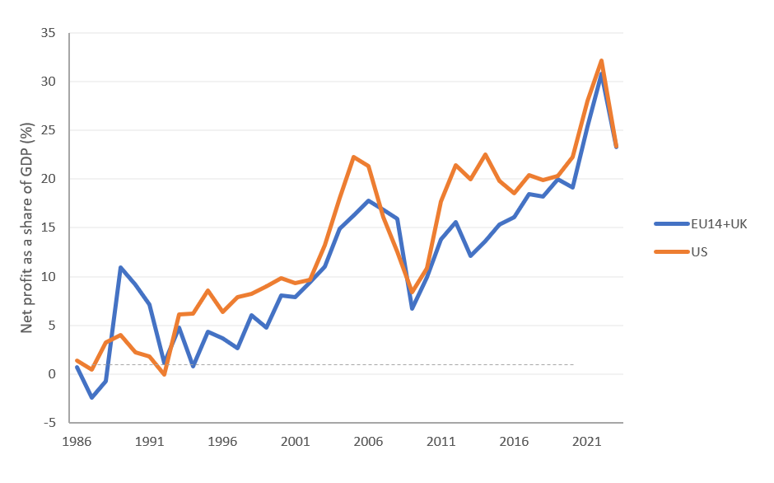
Findings on profits
Evolution of the net profit share of GDP EU vs. US
The net profit share of GDP increased from ~2% to more than 20% between 1986 and 2023
Markups and profits positively correlated
  suggesting that the rise of markups is not just driven by change in cost structures
Profit rates of the 50 most profitable large global firms (‘Global superstars’) increased from ~11% to ~20% between 1998 and 2022
Sources: Koltay et al. (2023, updated); OECD (Calligaris et al., 2024) for correlation analysis; Lear et al. (2024) for superstars

Slide 35
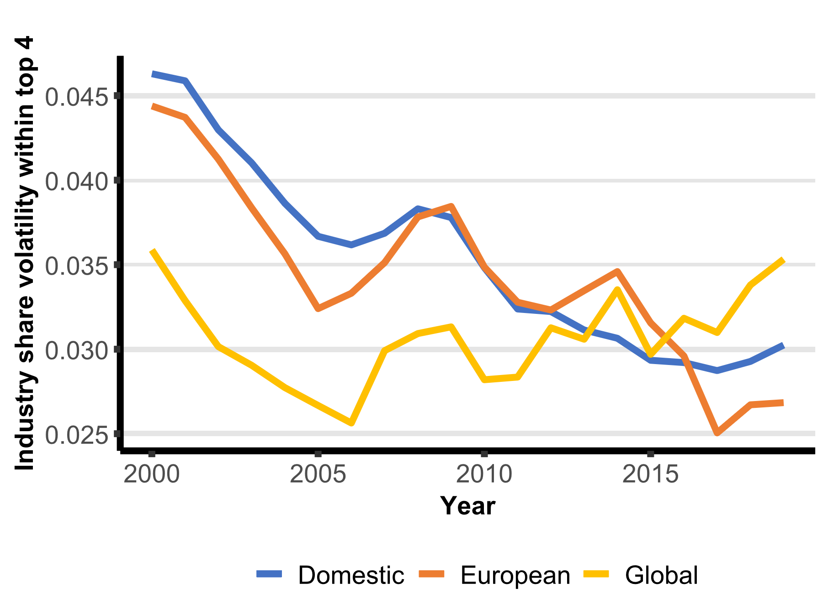
Findings on business dynamism
Less disruption amongst leaders (more entrenchment)
Growing gap between leaders and followers as regards markups, profits and productivity growth
  less diffusion of innovation and productivity improvements
Less entry and exit of firms
Industry share volatility (2000-2019)
Source: OECD (Calligaris et al., 2024)

Slide 36

Findings on main drivers
Technological change (ICT) + other intangibles (patents, brands)
Globalisation
Regulatory barriers to entry | ?
Rise of M&A/ underenforcement | ?
Largely structural changes over the past 25 years => both benign (efficiencies) and adverse (concentration, market power, barriers) effects on competition
Sector heterogeneity as regards direction and mix of drivers
On balance and on average, intensity of competition in the EU today is likely weaker and market power more pronounced than in the past
The observed changes in the nature and intensity of competition may have contributed to (i) lower business dynamism, (ii) slower productivity growth, (iii) decline of labour share, (iv) lower resilience to shocks

Slide 37





Price-Concentration studies section II.1 of the Commission’s report protecting competition in a changing world – based on Chapter 2 of the report Exploring aspects of the state of competition in the EU by Lear in consortium with ECA Economics, Fideres, Prometeia, University of East AngLia and Verian
Authors of the chapter: Hugo Bourrousse (EUI), Salvatore Carrozzo (Uni Parthenope), Sean Ennis (UEA), Mattia Nardotto (ULB), Antonio Neto (FIDERES), Chris Pike (FIDERES), Lorien Sabatino (PoliTo)
Salvatore Nava (Lear)

Slide 38
Overview
Assessment of the relationship between price and concentration in six sectors of economic activity, each covering a different set of countries
Identifying the causal effect of concentration on prices requires to:
  Control systematically for other determinants of prices
  Identify variations in market structure that are independent of prices and other market forces
Two main approaches:
  Descriptive data analysis seeking to identify correlations: beer, mortgages, supermarkets and cement
  Original empirical analyses seeking to identify causal links: mobile telecoms and airlines

Slide 39
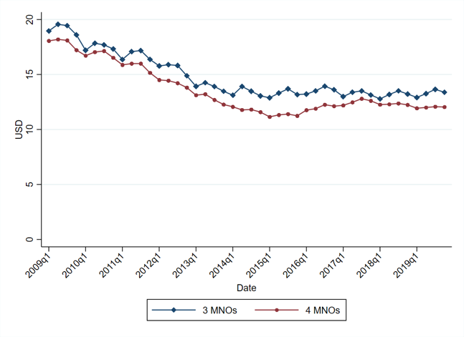
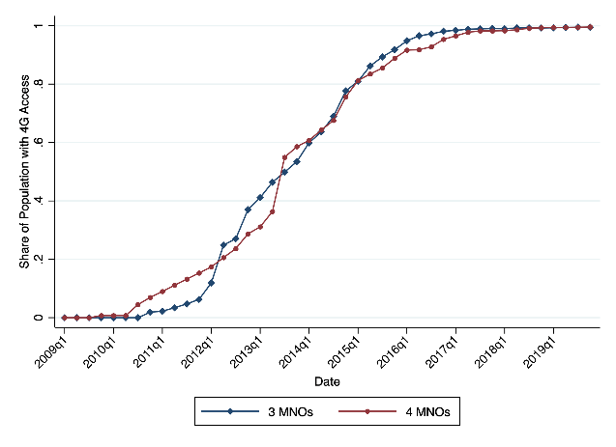
Mobile telecoms
Methodology: the number of MNOs is regressed on prices (MNOs’ ARPU) and investment (country-level CAPEX)
Scope of the analysis: 29 countries over the period 2009-2019
Findings on prices:
  EU countries with four MNOs have consistently lower prices than countries with three MNOs (top graph on the right)
  One additional MNO is associated with a 9% reduction in prices (restricting the sample to Europe)
  MVNOs exert a negligible competitive constraint on MNOs’ pricing
Findings on investment:
  4G rollout has moved at the same pace regardless of the number of MNOs (bottom graph on the right)
  Regression results find either no impact of concentration on investment or a negative impact (i.e. one additional MNO raises investment by 9%)
Evolution of ARPU in European countries based on the number of MNOs
4G roll-out in European countries based on the number of MNOs

Slide 40
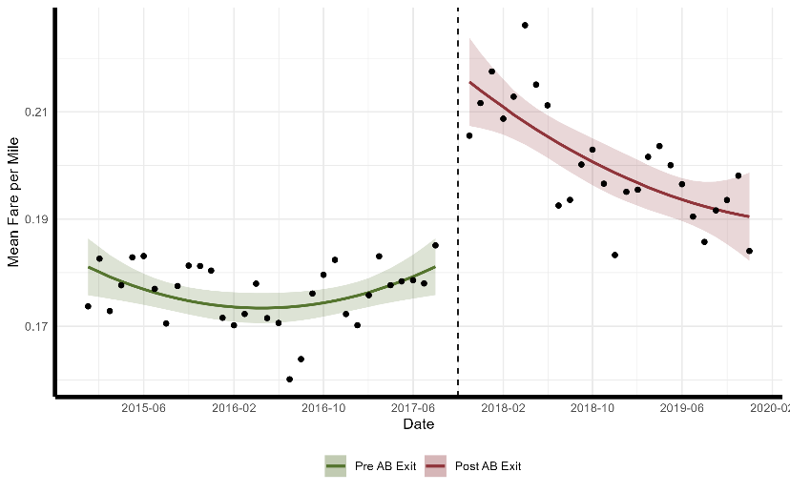
Airlines
Scope of the analysis: European routes in the period between January 2015 and December 2019
Methodology: exploiting the exit of Air Berlin to identify a causal impact of market structure on prices
  Exit occurred in October 2017
  Air Berlin was the 7th airline in Europe based on number of passengers, serving approx. 660 routes
Following Air Berlin’s exit (graph on the right):
  Prices increased by 19.4% (short-run effect)
  Prices on average 11% higher over the two years after Air Berlin’s exit
Price effects are even stronger (21% short-run effect) in routes with higher concentration prior to the exit (3 or less operators including Air Berlin)
Average fare per mile in the routes served by Air Berlin before (green) and after (red) its exit (dotted vertical line)

Slide 41
Key takeways
Market structure matters for prices. The descriptive analyses also identify interesting correlations that are paradigmatic of the difference market structure seems to make, e.g.:
  Mortgages: concentration in national banking markets seems to drive differences in interest rates paid by consumers
  Beer: due to (inter alia) a peculiar regulatory setup, Germany has much lower concentration and much lower prices
Identifying a truly causal relationship requires carefully designed empirical analyses (e.g. exploiting natural experiments like Air Berlin’s exit)
If telecom markets stay national in their geographic scope, further consolidation would likely raise prices, with no clear benefit on investment

Slide 42
Protecting Competition in a Changing World
Panel 2: Competition, prices and investments
Grania Holzwarth, Deutsche Telekom
October 15, 2024

Slide 43
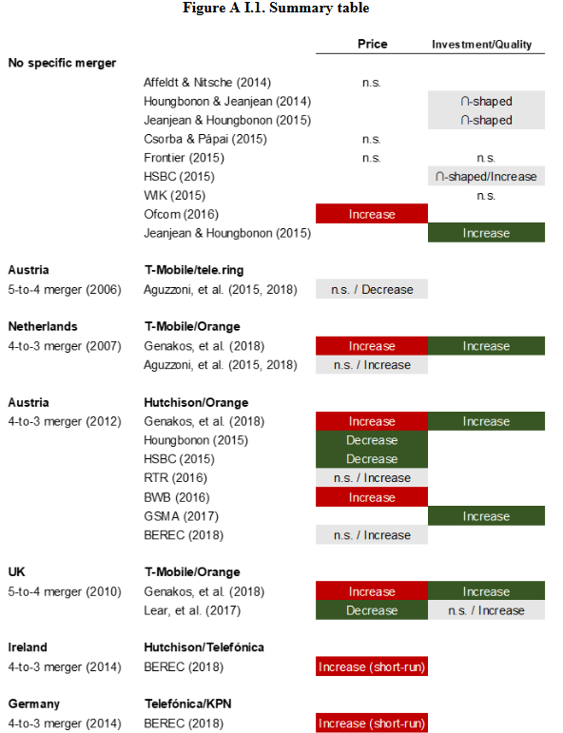
Static & Dynamic Effects of Mergers: A Review of Empirical Evidence in the Wireless Telecommunications Industry
OECD Background Note, September 2020, E.Fruits, J.Hurwitz,G.Manne, J.Morris & A.Stap
Metastudy finds
mixed price effects
Price: “Of the ten studies about half found that short-term prices decreased following a merger whereas half found that short-term prices increased.“
Investment: “studies that considered the effect on long-term investment of such mergers, all found that capital expenditures increased post-merger.”

Slide 44
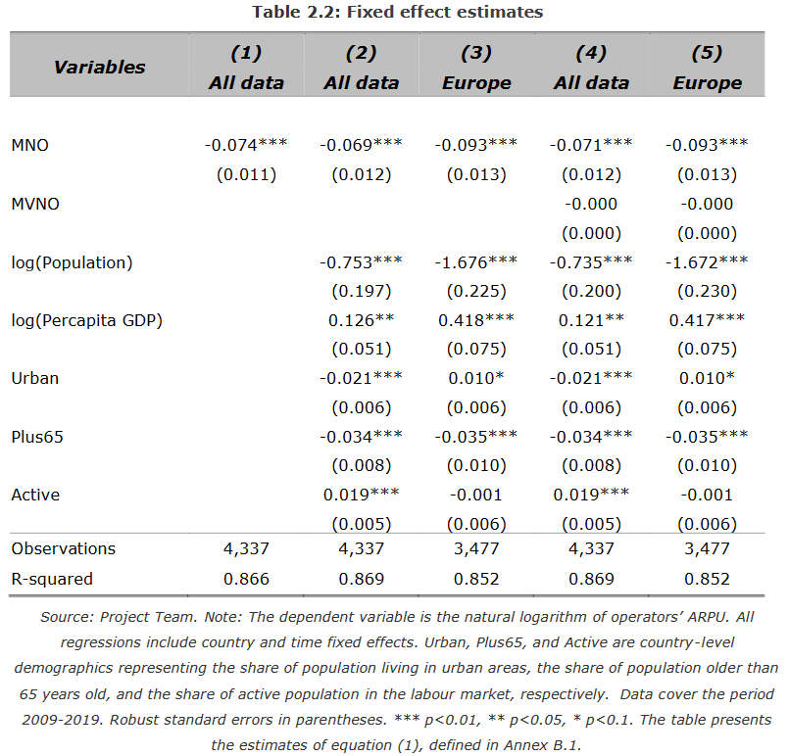
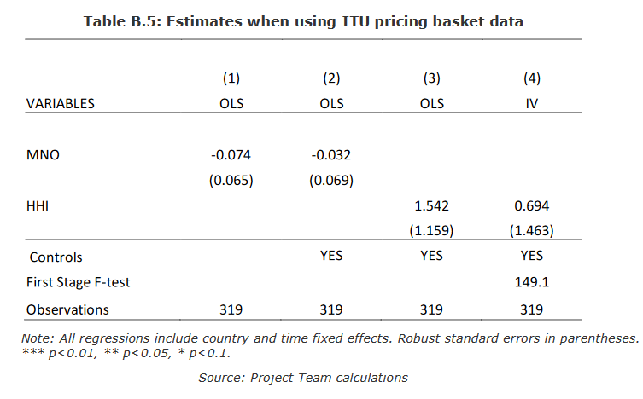
Lear study similar mixed price effect results looking at baskets there is no significant impact on prices

Slide 45

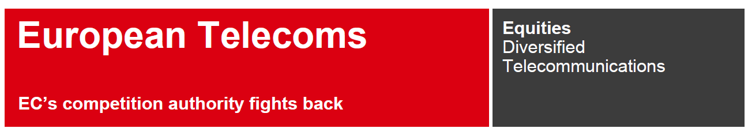
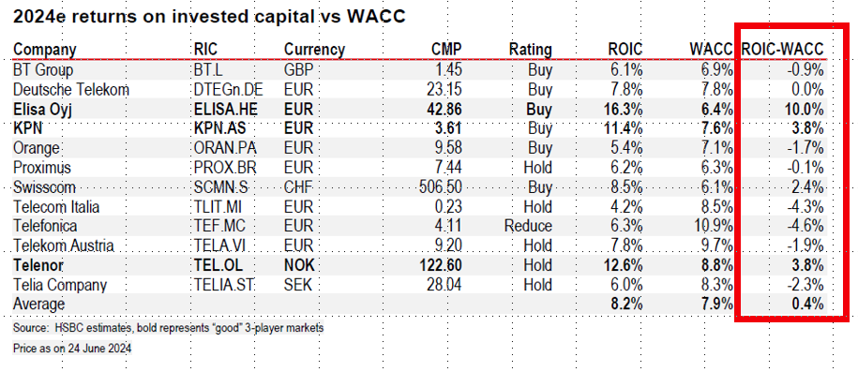
Most operators do not earn their cost of capital therefore lose their incentive and ability to invest

Slide 46
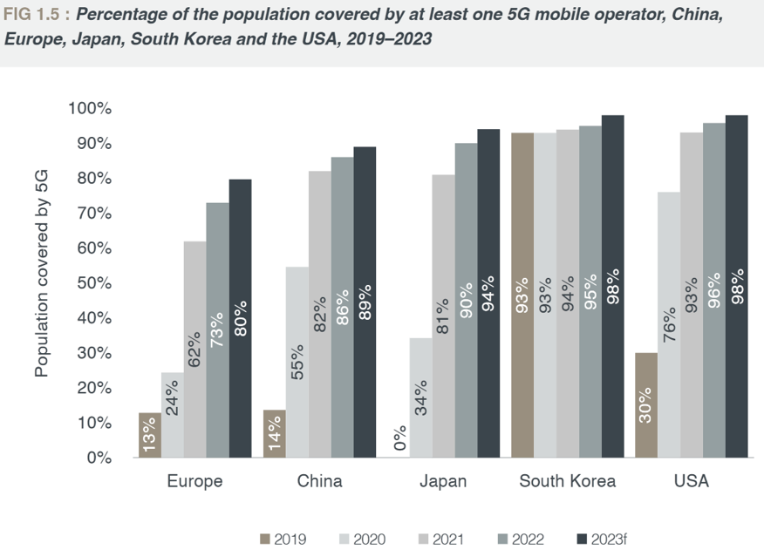
Investment gap effects overall EU competitivness
“The future competitiveness of all sectors of Europe’s economy depends on these advanced digital network infrastructures and services, as they form the basis for global GDP growth between EUR 1 and 2 trillion.”
EC White Paper “How to master Europe’s digital infrastructure needs?” 2024
Source: Connect Europe, State of Digital Communications 2024

Slide 47
Competition, competitiveness and growth
Paolo Buccirossi

Slide 48
Questions
Does domestic market competition help firms to be competitive in foreign markets?
What is the macroeconomic impact of curbing market power?

Slide 49
Competition and export competitiveness
Competition in input markets: positive effect on export performance (lower costs and higher quality of inputs)
Competition in the own market:
  Positive effect: increased incentive to innovate and improve quality [Donghwan & Marion, 1997; Hollis, 2003; Clougherty & Zhang, 2009]
  Negative effect: competition prevents firms from reaching the scale that enables them to compete effectively in international markets (national export champions argument) [Pagoulatos & Sorensen, 1976; Chou, 1986]

Slide 50
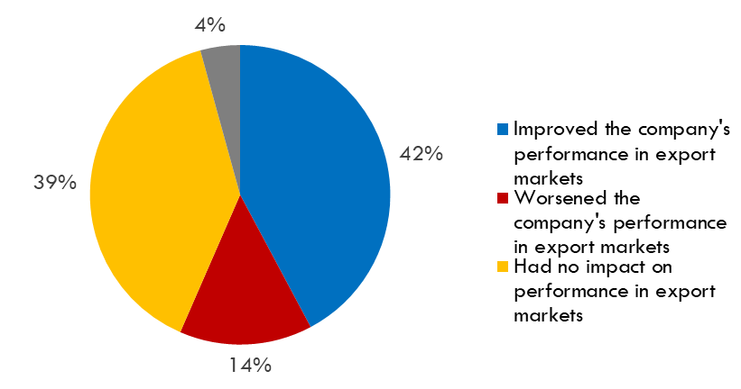
Domestic market for the export product (I)
Perceived effect of domestic competition on performance in export markets:

Slide 51
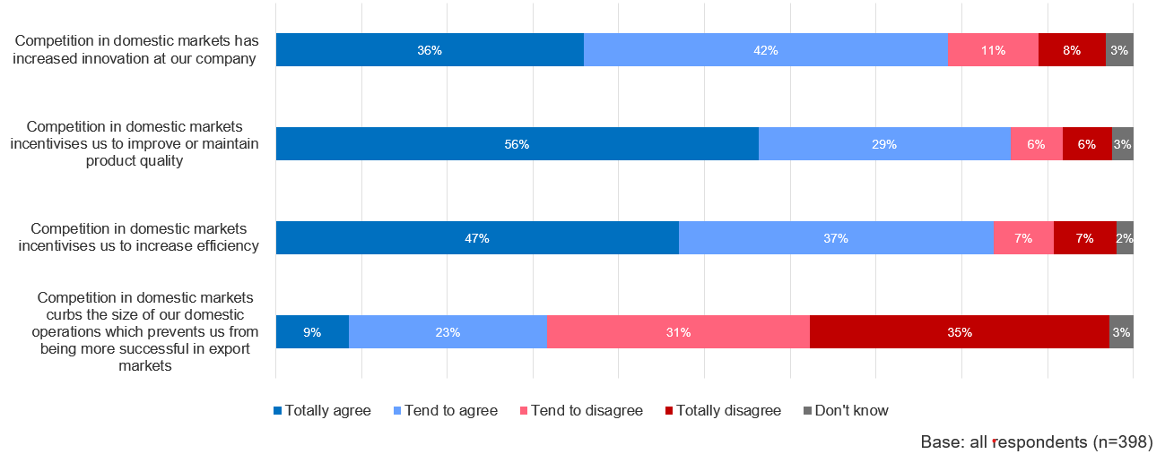





Domestic market for the export product
Channels through which domestic competition affects export performance:

Slide 52
Macroeconomic impact of market power: channels
Consumption: Higher prices from monopolies or oligopolies reduce consumer purchasing power, lowering overall consumption
Investment: Lack of competitive pressure leads to reduced business incentives to innovate and invest in new technologies, decreasing capital formation
Government Spending: Reduced tax revenue from lower economic growth impacts government capacity for public spending and services
Net Exports: Domestic firms may become less competitive globally, reducing exports and increasing imports

Slide 53
Macroeconomic impact of market power: size
Three hypothetical scenarios relying on an established macroeconomic model
Backward-looking simulation: the increase in markups observed in the EU since 2000 may have reduced EU GDP by up to 5 - 7% compared to the counterfactual
Two alternative forward-looking simulations: (1) measures limiting the market power of firms at the top of the markup distribution (“trimming scenario”) or (2) pro-competitive reforms across the EU (“convergence scenario”) might increase GDP by up to 2 - 4 %

Slide 54
Protecting competition in a changing world – public workshop
Comments in Panel 3:
Competition, productivity, competitiveness, and growth
Maarten Pieter Schinkel
Brussels, October 15th 2024
Notes:
We can talk about Part II, Section II.2 – the topic of this panel. We can quibble about issues with the use of questionnaires. Or about in II.3: criticize the general equilibrium/macro-modelling with MATER and Quest (which finds that without Competition Law Enforcement the relative increase in EU/US market concentration increases and reduced growth would have been another 25% bigger.) And that going forward, limited market power of the most powerful firms in Europe would add another 2-4% to GPD. A lot can be said – about the models (my own CPB is very good at this! And still); about the precise numbers.
.
But I believe the general qualitative conclusions: competition law enforcement is a good thing for welfare; despite corporate interests’ ability to still consolidate.
And there are so many more reports. Since also. ‘Competitiveness’ is the name of the game now – Draghi report. What does it mean?

Slide 55
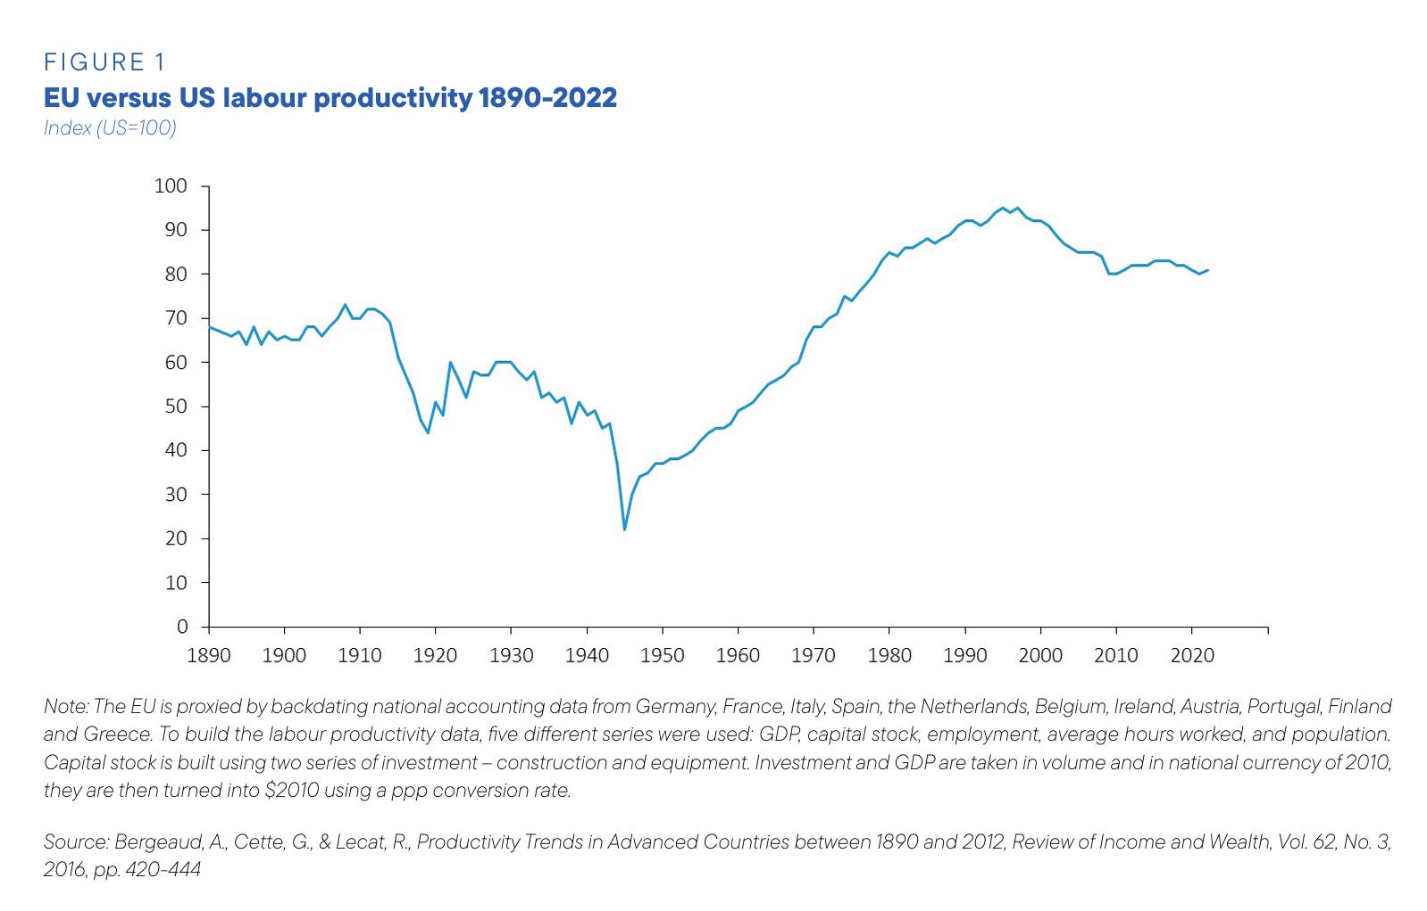
Notes:
Draghi seems to use “competitiveness” in the “poetic way” – that is, in the best possible way meant by Krugman (1994): as meaning “productivity” – or otherwise it it a dangerous obsession, as Krugman graphically pointed out.
Decreasing EU/US productivity ratio since the mid 90s. Since internet/the rise of Big Tech.
But we know: domestic competition increases efficiency, R&D, adoption of innovation (“dynamic effects”), certainly also of the Schumpeterian type, stimulates productivity.

Slide 56
Notes:
Confirmed by the report:
More innovation. Also 2/3 respondents says that domestic upstream competition helps firms’ ability to compete outside their home market/theEEA.
“weak competition undermines productivity growth”
Competition creates competitivess (in the meaning of productivity).

Slide 57
Notes:
So what then justifies these statements and the mission? Is competition policy “in the way of innovation”? Why the need for “reforming competition policy”? – which appears to mean relaxing merger control.
What then is wrong with competition policy?
Well, not so much. When you look more micro:

Slide 58
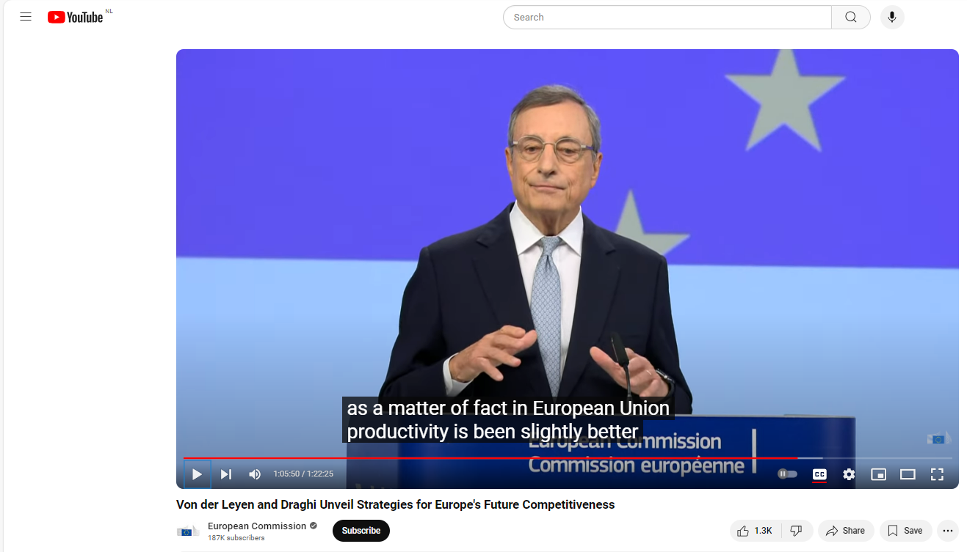
“We look at the US economy and we see that most of the productivity is concentrated in the high-tech sector. So we did this experiment: we took the high-tech sector out of the US economy and we asked the question: ‘How are the two continents comparable? How is productivity now?’ Well, as a matter of fact, in the European Union, productivity has been slightly better than it was in the US if you take the high-tech sector out.”
Mario Draghi in the 17-09-2024 press conference – at 1:05:50.
Notes:
The productivity gap is Big Tech – which is all US, and which appropriates its rents (as monopolies).
It is NOT wages, or fixed labor contracts. (Energy yes – but that is a different chapter.) Draghi responding to question about this.
Draghi in the 17-09-2024 press conference – at 1:05:50, in response to a question on whether competitiveness means we need lower labor costs and more flexibility.
[So maybe we should build a EUROStack – Airbus style – but that is a separate quest.]
We can hardly blame TOO MUCH competition law enforcement in Europe for the American Big Tech monopolies. Or did COMP kill the Euro Stack? I doubt it.

Slide 59
Notes:
Consistent also with study by The European Policy Analysis Group – CESIfo/Bocconi/Toulouse, presented by David Gros and Jean Tirole.

Slide 60
Notes:
EU is good at innovation in mid-tech; the pick parts; cars. Not in high-tech: US. Big Tech and Big Pharma. (And overall EU not so bad.)
The report focusses on allocating the large EU R&D funds differently – a good idea.
BUT ALSO: Only 1/3 of our EU inventions, we develop to market!
We are not getting to doing the big stuff.

Slide 61
Source: Reinhilde Veugelers, Coordination for EU competitiveness, presentation in The Hague, 11 October 2024.
Notes:
The frontier firms are doing fine, but mostly in ICT. Spread bigger in ICT-intensive.
What if laggards are keeping the EU stats down? How do we get the laggards to innovate or apply innovation more? (I could not find very detailed breakdowns – but should be available data.)
How to get out of the middle technology trap?

Slide 62
Notes:
Bruegel for years has pointed at the need for more market integration. The EU markets are terribly fragmented by regulations, incomparabilities, red tape,
Conflicting regulatory environments across the Single Market – e.g. related to spectrum allocation in mobile telephony. (ERT, factsheet, page 7)
little and large barrriers to entry.
National state aids – that essential held up the transitioning to better technology – e.g. electric cars in Germany.
Nationally shielded markets in which local firms are shielded from real competition . Become laggards.

Slide 63
Notes:
Market concentration much higher in domestic markets. (Okay, smaller: Sutton-effect.) But many markets are domestic RELEVANT markets.
Markets share (numerator) divided by size of the relevant market (denominator). Despite good COMP work, numerator has grown more than the denominator (if that moved at all).
Well-known are consumer and SME banking; mobile telephony; household energy markets. But many more.
In part kept closed by vested interests – banks. With all sorts of lobbies for entry barriers (financial stability safety; information problems (how to appraise foreign collateral?); privacy).
Study: zoom in on relevant market dynamics.

Slide 64
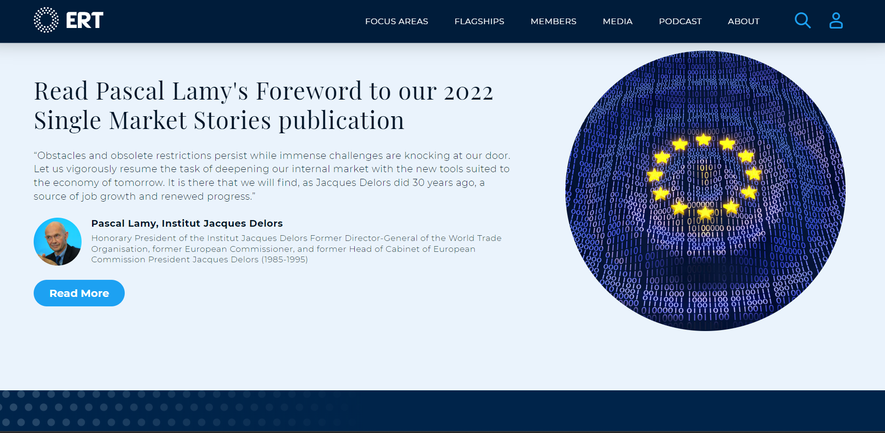
Notes:
However, also the industry itself wants to break this open.
European Round Table for Industry.
Most important missing market: finance for start-ups. Which the ERT wants to break open – just like Letta and Draghi do. Capital Markets Union (CMU).
(Note sure ,if the notorious vested interests are at the Round Table …).

Slide 65
Notes:
But how does ERT want to do it? Well, tough competition policy!

Slide 66
Notes:
So what about that worrying left-over recommendation in Chapter 3.1 – that the reviewers of Chapter 4 did not catch, it seems?
Gets merger control al wrong and upside-down – as Benoit Coeuré (president of the French Competition Authority) pointed out in his early review of the Letta report.
Instead of “defining” the telecomm market, this should read “First create …”
Until the denominator is enlarged (ie larger relevant market), we should not allow “mergers to scale”. Those are not going to lead to market integration – and they will only slow down Sschumpeterian competition and market dynamism.
[For mind you, while 27 operators may be very many more than in China or the US, that could still be 27 local national monopolies – maybe even half the number (54) needed if these 27 do not enter into each others home markets.]
But that is a task for DG GROW, not COMP!

Slide 67
Notes:
Commissioner for Internal Market – i.e. Prosperity and Industrial Strategy. Market enlargement there. At last – Letta; decades of hold-up.
Single Market Enforcement Taskforce – not exactly a DG MINT, as ERT calls for, but “reinforced”.
Once markets are wider, larger denominator; allows for larger numerator.
De denominator (size of the relevant market) is DG GROW’s responsibility. Not something that COMP can increase simply by allowing cross-border mergers.
Is there then nothing for COMP? Is competition policy a side-dish? No.
[Mind you: competition is a public good itself – with lots of positive externalities.]
Draghi report revamps NCT (thanks to Fiona):

Slide 68
Notes:
Recommendation 9 in Chapter 3, page 303 of Draghi report Part B.
NCT can clean out barriers to European market integration. From little to larger. That way, COMP can help create the EU wide market size that may allow mergers to scale – on that larger market. With a larger denominator, we can have larger numerator.

Slide 69
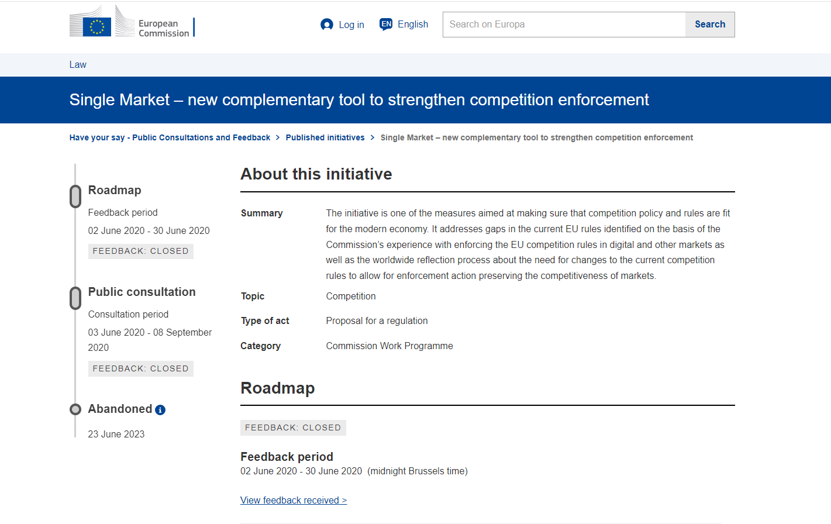
Notes:
Shelved after a full trajectory – including Regulatory Impact Assessment.
Ready to be dusted off and used for European Market Integration.
Let me leave it at this for now.

