Slide 1
Shelving or Developing?
The acquisition of potential competitors
under financial constraints
Fumagalli, Motta and Tarantino
Discussion
EAGCP Meeting | 17 June 2022 | Hendrik Meder

Slide 2
Preventing killer acquisitions by a simple rule?
The goal: A merger policy allowing acquirers to finance constraint innovative start-ups while preventing acquisitions that solely pre-empt competition.
Simple mechanism: Prohibition of all early-stage acquisitions that are subject to a significant premium paid.
Price as signal of anti-competitive deal determining the rule when to prohibit.
The model explicitly allows for acquisitions but mechanism selects only welfare-beneficial and pro-competitive deals on the expense of sacrificing some if the price is (too) high.
Proposal towards stricter enforcement of acquisition of start-ups.

Slide 3
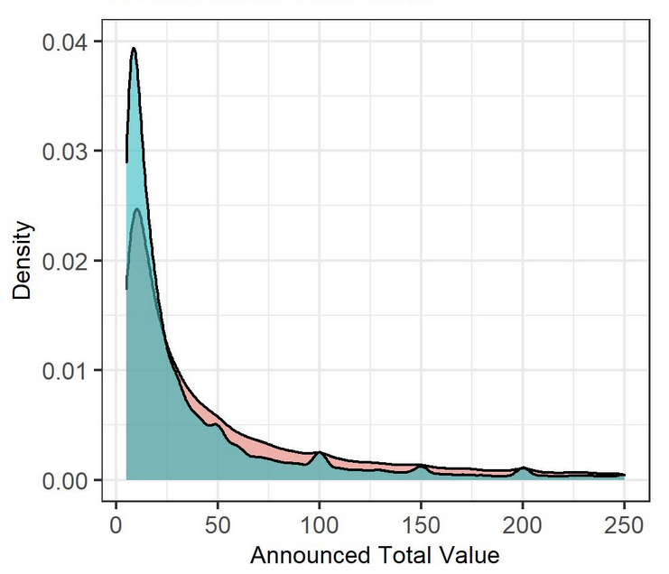
How to judge when price is (too) high?
“AAs generally lack the sophisticated financial ability necessary to interpret the relevant data, […].”
Valuations based on Series A, B, C Funding rounds are at best a rule of thumb.
Who knows? VC invests in 7 failures out of 10 start-ups.
How to determine the fair price in the light of uncertainty about survival, success or future revenues and profits.
Differences at round figures are significant for digital acquisitions!
Source: Garbe & Malikova, 2022, based on Bloomberg Data

Slide 4
Informative value of purchase prices
It is difficult to distinguish why a premium is paid:
Benefits from pre-empting competition.
Future efficiencies that cannot be technologically discovered/verified by the AA and/or the market.
Multiple bidders for the target.
Is there any evidence that premium paid is significantly higher if horizontal overlap exists?
It is a problem of jurisdiction and no rule, based on purchase price, is needed:
AA have the knowledge and abilities to identify anti-competitive acquisitions if you let them do their job in the normal course of an investigation of an antitrust market and not an “industry”.
A rule based on a purchase price will not be enforceable under any jurisdiction.
(Relative) price only as potential additonal threshold to investigate.

Slide 5
Thank You!

Slide 6
Additional comments
Competition if the start-up would enter is left open. “[…], if developed, will allow it to compete with an incumbent firm.”
“Allow to compete”: Business stealing (imitation) vs offering a better product (innovation); see Dijk et al., 2022 as an example.
Prospect of buyouts (acquisition market) may have stronger positive innovation effects than the risk of anti-competitive “killer” acquisitions; see Hollenbeck, 2020.
Decline in IPOs and increase in acquisitions may be strongly correlated to the introduction and growth in SPACs since early 2010s.
Acquisition of financially constraint start-ups
Would same hold for patent or license acquisition?

Slide 7
References
Dijk, Esmee S.R., Jose L. Moraga-Gonzalez and Evgenia Motchenkova, 2022, ”Start-ups, reverse killer acquisitions, and incumbent’s, direction of innovation”, working paper
Garbe, Lisa and Helena Malikova, 2022, “Digital merger efficiencies in real life”, working paper
Hollenbeck, Brett, 2020, “Horizontal mergers and innovation in concentrated industries”, Quantitative Marketing and Economics.
Regibeau, Pierre, 2021, “Killer acquisitions? Evidence and potential theories of harm”, working paper.

